Slide 1
WELCOME TO MY PRESENTATION

Slide 2
A STUDY ON CALCULATING GDP AND COST MINIMIZATION OF INDUSTRIES FOR PREVENTING AIR POLLUTION BY LEONTIEFS ECONOMIC MODELS
Sujoy Mondal
Department of Mathematics
University of Barishal

Slide 3
Presentation Outlines:
Leontief economic models.
Types of Leontief economic models.
Leontief’s closed model (Input-Output analysis).
The calculation of the minimum cost of sectors for preventing air pollution by Leontief’s closed model.
Leontief’s open model.
Calculation of GDP using Leontief’s open model.

Slide 4
Leontief economic models:
Production equals consumption when there are n industries each producing n different products. These industries are always dependent on each other.
That is:
Total Amount Produced = Internal Demand + External Demand

Slide 5
An overview:
Wassily Leontief was an economist who was one of the first people to do computational analysis of economics. Moreover, his work involved one of the first uses of a computer to produce this analysis, done in 1949 at Harvard. For his work he won a Nobel Prize in 1973. Economy is divided into sectors. Sectors produce products. To produce products sectors need input. Input must come from possibly all of the sectors including itself. The Leontief Model was created by Wassily Leontief in 1941.The model is used to describe industry production and consumption for a particular region or area.

Slide 6
There are two types of Leontief model:
Leontief closed model (Input-Output analysis).
Leontief open model.

Slide 7
Leontief’s closed model:
In a closed model:
1. All consumption is within the industries. There is no external demand.
2. Total input$=$ Total output
2. Total input = Total output
$p=$ $Ep$
𝑝= 𝐸𝑝
Where p is price vector and E is input output matrix.

Slide 8
Example:
Three neighbors have backyard vegetable gardens. Neighbor A grows tomatoes, neighbor B grows corn, and neighbor C grows lettuce. They agree to divide their crops among them- selves as follows: A gets $\frac{1}{2}$ of the tomatoes, $\frac{1}{3}$ of the corn, and $\frac{1}{4}$ of the lettuce. B gets $\frac{1}{3}$ of the tomatoes, $\frac{1}{3}$ of the corn, and $\frac{1}{4}$ of the lettuce. C gets $\frac{1}{6}$ of the tomatoes, $\frac{1}{3}$ of the corn, $\frac{1}{2}$ of the lettuce. What will be the prices of tomatoes, corn, lettuce to satisfy the final demands?
Three neighbors have backyard vegetable gardens. Neighbor A grows tomatoes, neighbor B grows corn, and neighbor C grows lettuce. They agree to divide their crops among them- selves as follows: A gets 1/2 of the tomatoes, 1/3 of the corn, and 1/4 of the lettuce. B gets 1/3 of the tomatoes, 1/3 of the corn, and 1/4 of the lettuce. C gets 1/6 of the tomatoes, 1/3 of the corn, 1/2 of the lettuce. What will be the prices of tomatoes, corn, lettuce to satisfy the final demands?

Slide 9
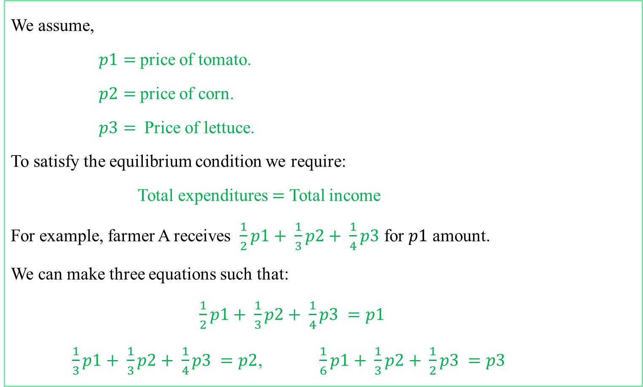
Solution:
We assume,
$p1=$price of tomato.
$p2=$price of corn.
$p3=$ Price of lettuce.
To satisfy the equilibrium condition we require:
Total expenditures $=$ Total income
For example, farmer A receives $\frac{1}{2}p1+ \frac{1}{3}p2+ \frac{1}{4}p3$ for $p1$ amount.
We can make three equations such that:
$\frac{1}{2}p1+ \frac{1}{3}p2+ \frac{1}{4}p3 =p1$
$\frac{1}{3}p1+ \frac{1}{3}p2+ \frac{1}{4}p3 =p2$, $\frac{1}{6}p1+ \frac{1}{3}p2+ \frac{1}{2}p3 =p3$

Slide 10

Rewriting these equations in matrix form we get:
$\left[\begin{matrix}\frac{1}{2} & \frac{1}{3} & \frac{1}{4} \\ \frac{1}{3} & \frac{1}{3} & \frac{1}{4} \\ \frac{1}{6} & \frac{1}{3} & \frac{1}{2}\end{matrix}\right] \left[\begin{matrix}p1 \\ p2 \\ p3\end{matrix}\right] = \left[\begin{matrix}p1 \\ p2 \\ p3\end{matrix}\right]…………….(1)$
Equation (1) is referred as $Ep =p$.
Where $E$ is exchange matrix or input-output matrix and $p$ is price vector.

Slide 11
After calculation we get the values of $p_{1} , p_{2} , p_{3}:$
After calculation we get the values of 𝑝_1 , 𝑝_2 , 𝑝_3:
$$\left[\begin{matrix}p1 \\ p2 \\ p3\end{matrix}\right] =s \left[\begin{matrix}18 \\ 15 \\ 16\end{matrix}\right]$$
[■8(𝑝1@𝑝2@𝑝3)] =𝑠 [■8(18@15@16)]
Where $s$ is an arbitrary constant. We can set the value of $s$ and determine the prices of tomatoes, corn and lettuce that satisfies the final demand.
Where 𝑠 is an arbitrary constant. We can set the value of 𝑠 and determine the prices of tomatoes, corn and lettuce that satisfies the final demand.

Slide 12
The calculation of the minimum cost of sectors for preventing air pollution by Leontief’s closed model:
Pollutants are byproducts of industries. Economic activities that would mitigate the environmental disruption that accompanies industrial operations can also be incorporated into an appropriately expanded input-output system.The minimum cost of sectors for preventing air pollution can be measured by Leontief’s input-output model.

Slide 13
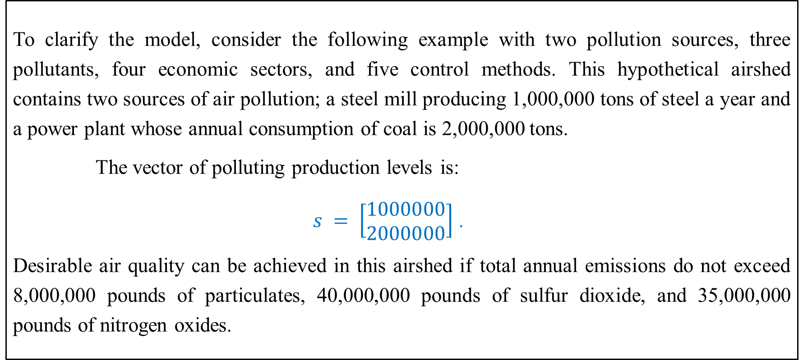
Example:
To clarify the model, consider the following example with two pollution sources, three pollutants, four economic sectors, and five control methods. This hypothetical airshed contains two sources of air pollution; a steel mill producing 1,000,000 tons of steel a year and a power plant whose annual consumption of coal is 2,000,000 tons.
The vector of polluting production levels is:
$s = \left[\begin{matrix}1000000 \\ 2000000\end{matrix}\right]$ .
Desirable air quality can be achieved in this airshed if total annual emissions do not exceed 8,000,000 pounds of particulates, 40,000,000 pounds of sulfur dioxide, and 35,000,000 pounds of nitrogen oxides.

Slide 14
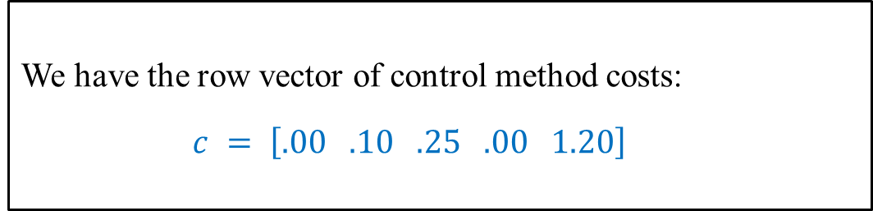
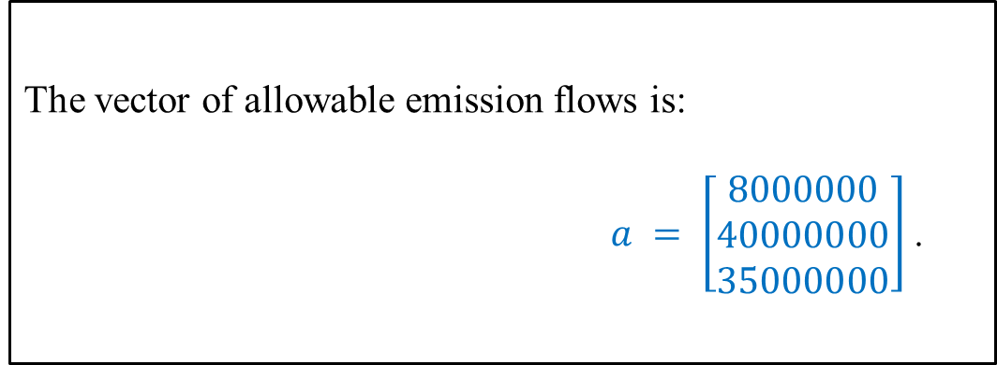
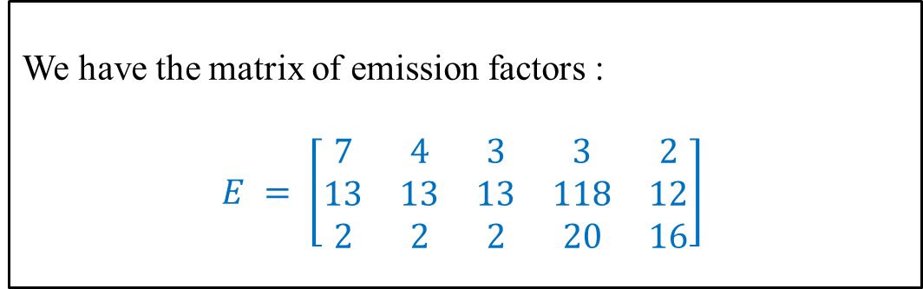
The vector of allowable emission flows is:
$a = \left[\begin{matrix}8000000 \\ 40000000 \\ 35000000\end{matrix}\right]$ .
We have the row vector of control method costs:
$c = \left[.00 .10 .25 .00 1.20\right]$
We have the matrix of emission factors :
$E = \left[\begin{matrix}7 & 4 & 3 & 3 & 2 \\ 13 & 13 & 13 & 118 & 12 \\ 2 & 2 & 2 & 20 & 16\end{matrix}\right]$

Slide 15

The distributive matrix which equates the sum of control method activities for each pollution source to the production level of that source is:
$u = \left[\begin{matrix}1 & 1 & 1 & 0 & 0 \\ 0 & 0 & 0 & 1 & 1\end{matrix}\right]$
The linear programming model in standard form is:
$minimize Z = .00x1+ .10x2+ .25x3+ .00x4+1.2$
Subject to
$x1+ x2+ x3+ =1000000$
$x4 + x5 = 2000000$
$7x1 + 4x2+ 3x3+3x4 +2x5 =8000000$
$13x1+13x2+13x3+118x4+ 12x5 = 40000000$
$2x1 + 2x2 +2x3 + 20x4 +16x5 = 35000000$
$x1, x2,x3,x4,x5 =0$

Slide 16
The optimal solution is: $x1= 0$ tons of steel, $x2 = 971,698$ tons of steel, $x3 = 28,302$ tons of steel, $x4 = 28,302$ tons of coal, $x5 = 1,971,698$ tons of coal and $Z =\$ 2470283$.So the minimum cost of preventing air pollution by these sectors is: $2470283
The optimal solution is: 𝑥1= 0 tons of steel, 𝑥2 = 971,698 tons of steel, 𝑥3 = 28,302 tons of steel, 𝑥4 = 28,302 tons of coal, 𝑥5 = 1,971,698 tons of coal and 𝑍 =$ 2470283.So the minimum cost of preventing air pollution by these sectors is: $2470283

Slide 17
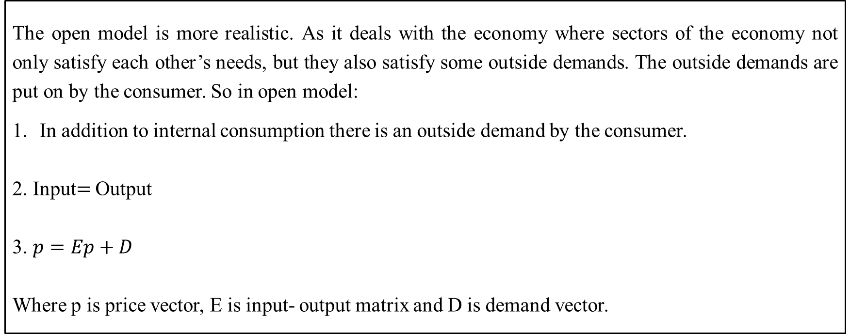
Leontief’s Open Model:
The open model is more realistic. As it deals with the economy where sectors of the economy not only satisfy each other’s needs, but they also satisfy some outside demands. The outside demands are put on by the consumer. So in open model:
In addition to internal consumption there is an outside demand by the consumer.
2. Input$=$ Output
3. $p=Ep+D$
Where p is price vector, E is input- output matrix and D is demand vector.

Slide 18
Calculation of GDP using Leontief’s open model:
In Leontief’s open model, the Gross Domestic Product (GDP) can be calculated using the formula:
$$GDP={(I−A)}^{−1}Y$$
𝐺𝐷𝑃=〖(𝐼−𝐴)〗^(−1) 𝑌
Where:
I is the identity matrix.
A is the matrix of coefficients representing the proportion of inputs from each sector required to produce one unit of output.
Y is the final demand vector.

Slide 19
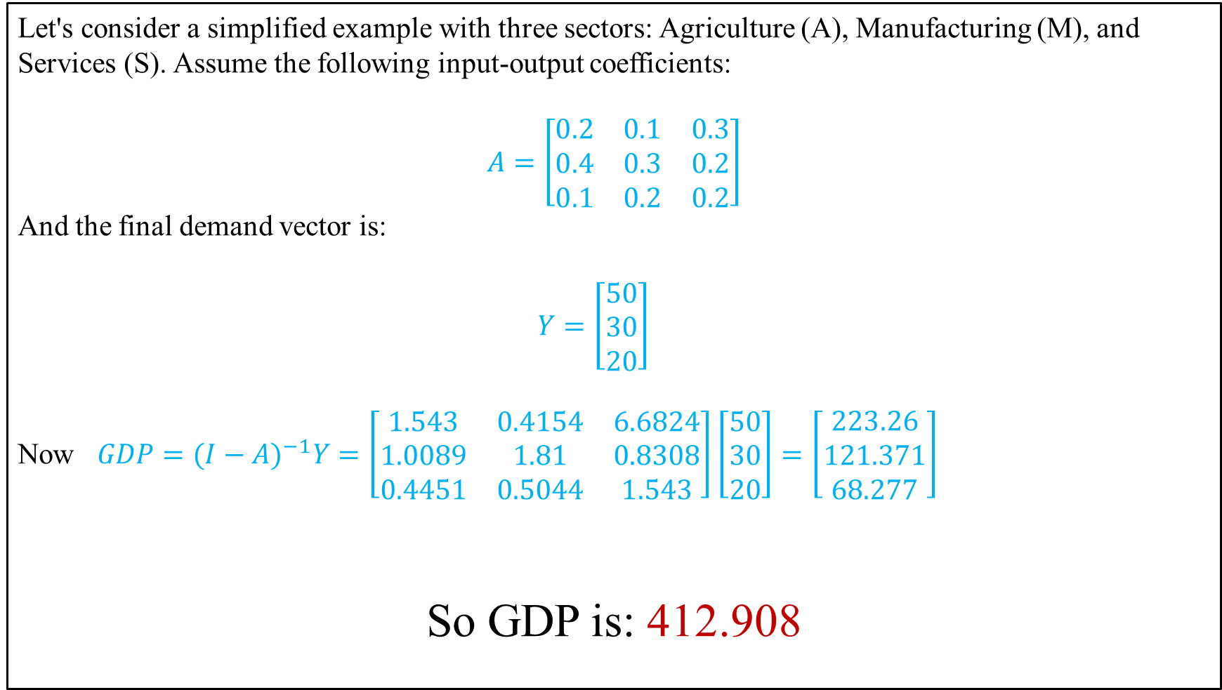
Let's consider a simplified example with three sectors: Agriculture (A), Manufacturing (M), and Services (S). Assume the following input-output coefficients:
$$A=\left[\begin{matrix}0.2 & 0.1 & 0.3 \\ 0.4 & 0.3 & 0.2 \\ 0.1 & 0.2 & 0.2\end{matrix}\right]$$
And the final demand vector is:
$Y=\left[\begin{matrix}50 \\ 30 \\ 20\end{matrix}\right]$
Now $GDP=({I−A)}^{−1}Y=\left[\begin{matrix}1.543 & 0.4154 & 6.6824 \\ 1.0089 & 1.81 & 0.8308 \\ 0.4451 & 0.5044 & 1.543\end{matrix}\right]\left[\begin{matrix}50 \\ 30 \\ 20\end{matrix}\right]=\left[\begin{matrix}223.26 \\ 121.371 \\ 68.277\end{matrix}\right]$
So GDP is: 412.908

Slide 20
Conclusion:
Our goal is to design economic plans for maintaining economical relationship of industries while producing products. Matrix theory is used to build these two types of economic models. In this presentation we discuss about two interrelated economical models. We minimize the cost of industries on preventing pollution while producing products by using the application of Leontief closed model and we calculate the GDP by using application of Leontief open model.

Slide 21
THANKS TO ALL

